Slide 1

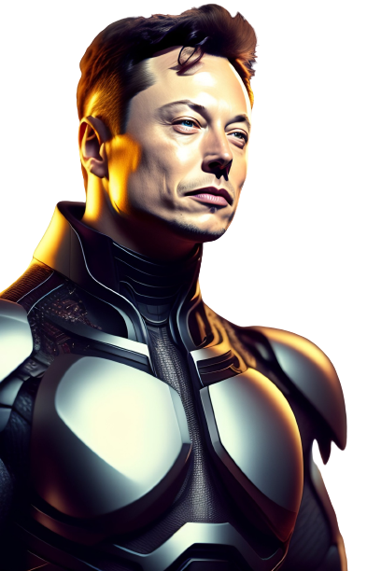
Autonomous driving level 4
______________
INFO4444
Presenters: Weilin Yang, Alexios Zhu, Yueqian Hu

Slide 2
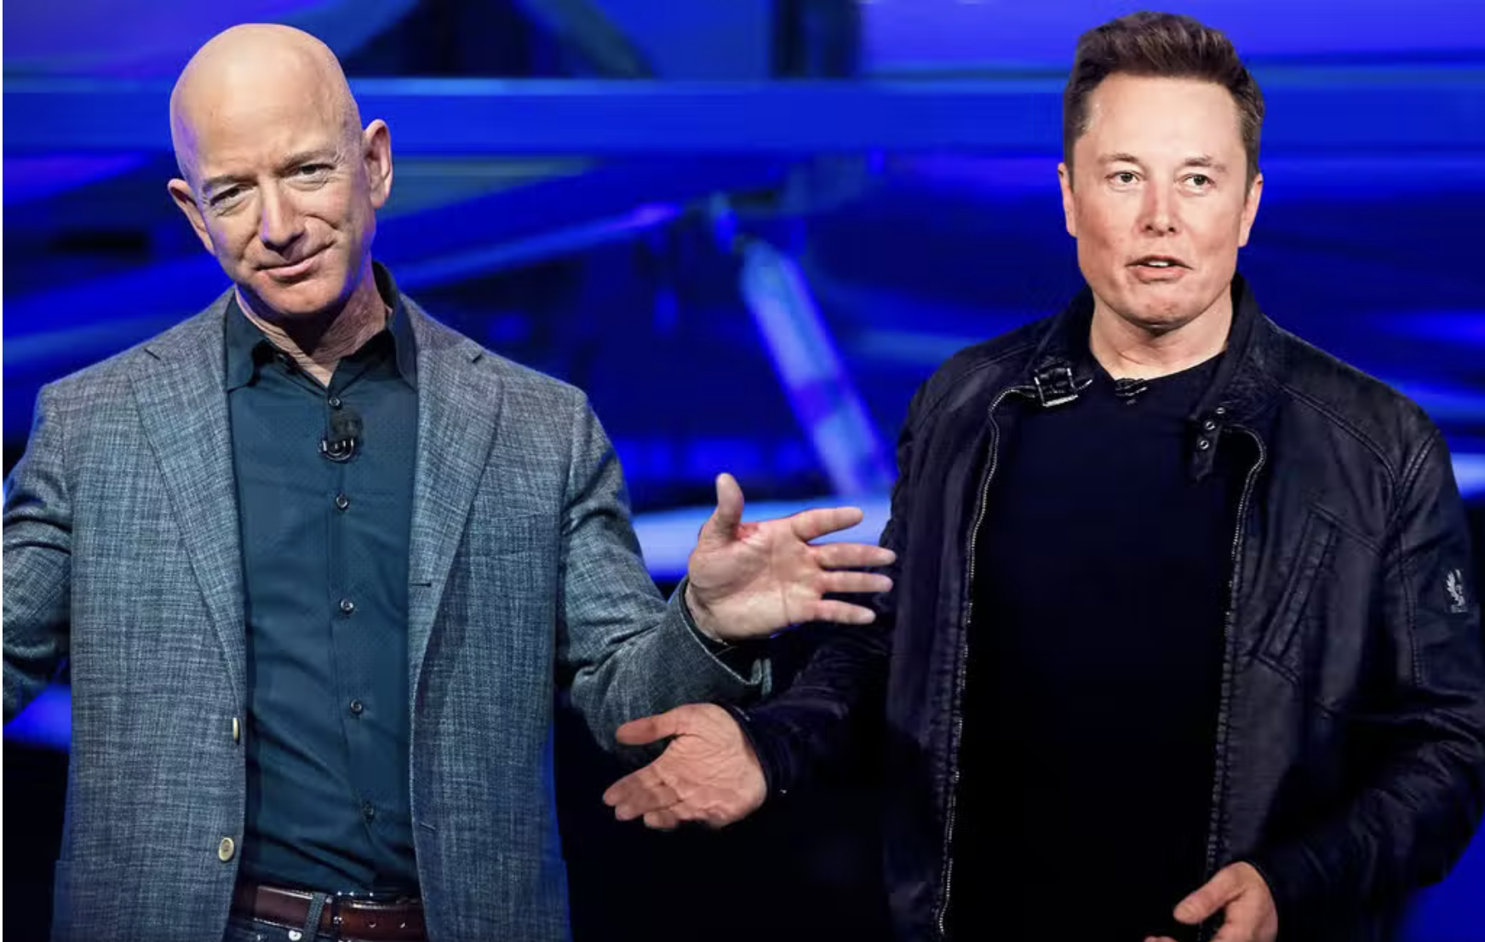

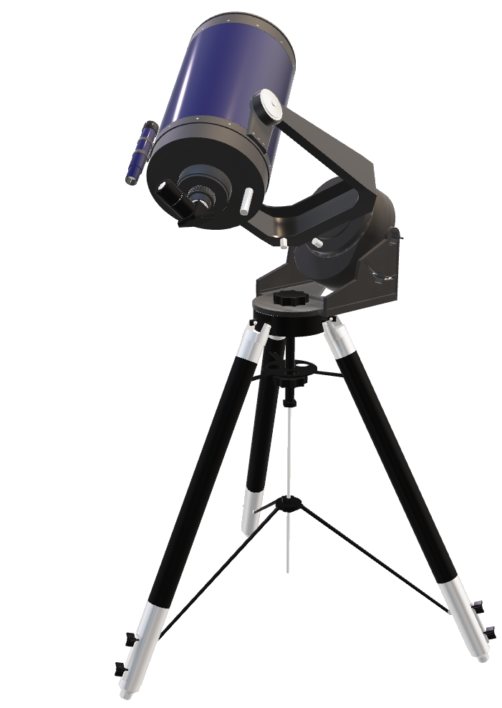
[Automobiles]
----------------------
Elon Musk
Specializes in electric vehicle manufacturing, energy storage systems, and solar panel production. The company was founded in 2003 by Elon Musk, Martin Eberhard, Marc Tarpenning, JB Straubel, and Ian Wright, with the goal of accelerating the transition to sustainable energy.

Slide 3

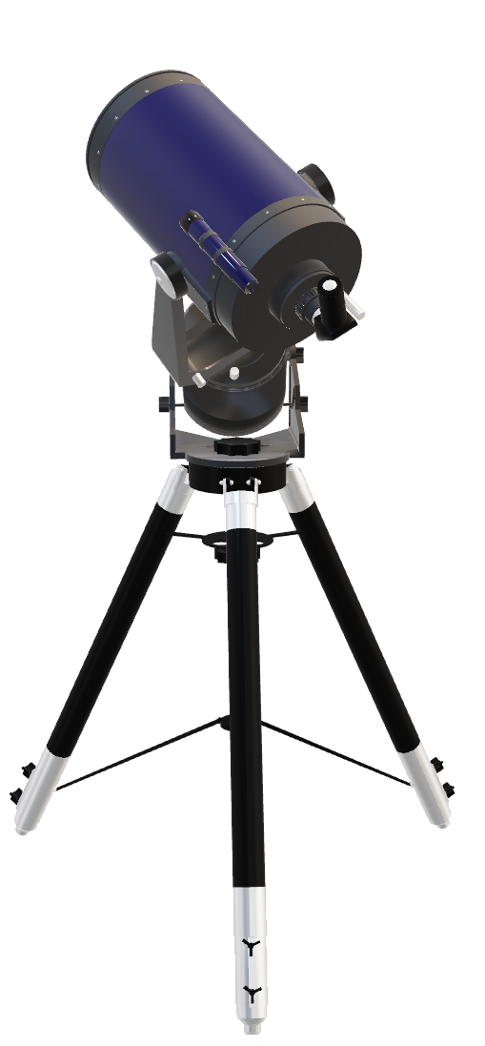
[Transport, Postal, Warehouse]
---------------
Andy Jassy
Using Self-driving trucks and delivery vehicles in various parts of the world to significantly reduce delivery times and costs while also improving efficiency and safety on the roads.

Slide 4
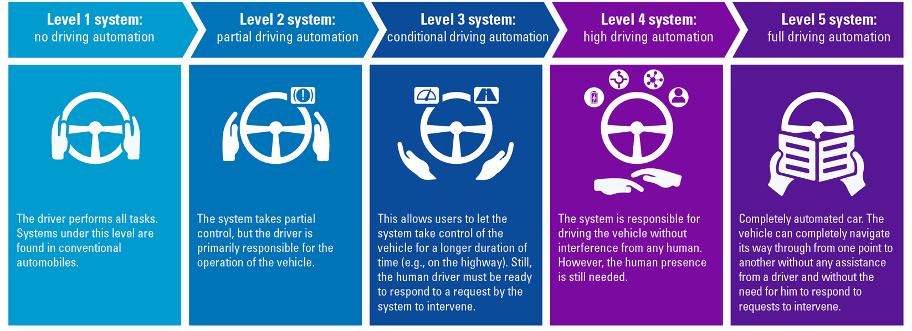

Slide 8
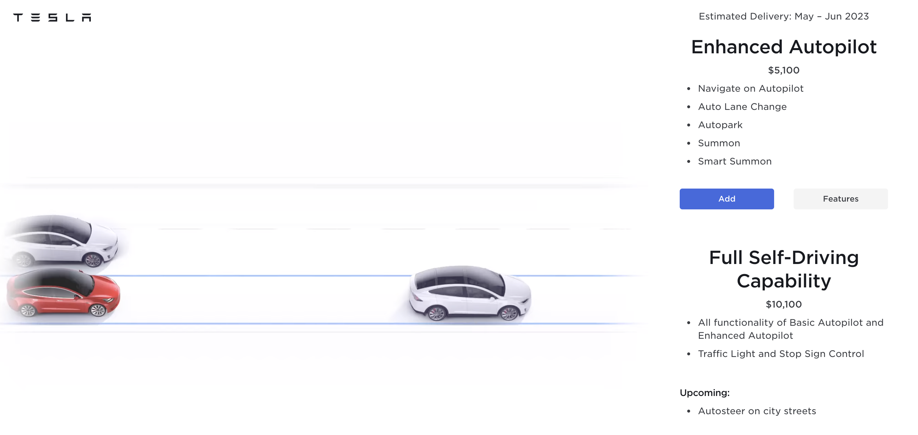

Slide 9







Value Proposition Canvas
Value Proposition Canvas
for Tesla
Customer jobs
Customer gains
Drive to work
Unique personal transport
Be adequate for long distance driving
Customer pains
High speed
High safety
Brand recognition
Fashion design
Lack of charging stations
Needs to be recharged frequently
Fear of accidents
Price drop after purchasing
Products & Services
Model 3, X, Y and S
8 year battery lifespan
High-satisfaction after sale services
Gain creators
High-tech touchscreen
High focus on style&design
Autonomous mode
0-100km/h 4.4s – 6.2s
Pain relievers
Tesla supercharge
High safety rating
262km-405km one single charge

Slide 10
Value Proposition Canvas
Value Proposition Canvas
for Tesla
Customer jobs
Customer gains
Drive to work
Unique personal transport
Be adequate for long distance driving
Customer pains
High speed
High safety
Brand recognition
Fashion design
Lack of charging stations
Needs to be recharged frequently
Fear of accidents
Price drop after purchasing
Products & Services
Model 3, X, Y and S
8 year battery lifespan
High-satisfaction after sale services
Gain creators
High-tech touchscreen
High focus on style&design
Autonomous mode
0-100km/h 4.4s – 6.2s
Pain relievers
Tesla supercharge
High safety rating
262km-405km one single charge

Slide 11
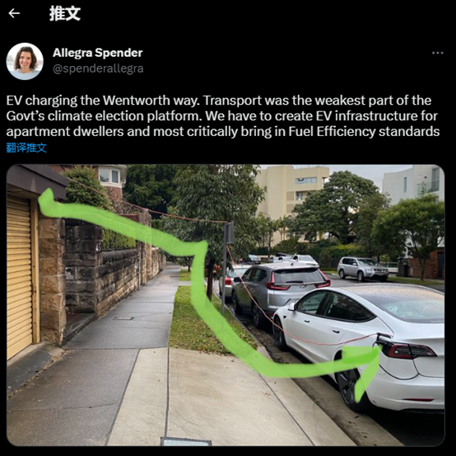
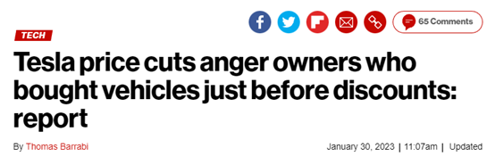
Value Proposition Canvas
Customer jobs
Value Proposition Canvas
for Tesla
Customer gains
Drive to work
Unique personal transport
Be adequate for long distance driving
Customer pains
High speed
High safety
Brand recognition
Fashion design
Lack of charging stations
Needs to be recharged frequently
Fear of accidents
Price drop after purchasing
Products & Services
Model 3, X, Y and S
8 year battery lifespan
High-satisfaction after sale services
Gain creators
High-tech touchscreen
High focus on style&design
Autonomous mode
0-100km/h 4.4s – 6.2s
Pain relievers
Tesla supercharge
High safety rating
262km-405km one single charge

Slide 12
Value Proposition Canvas
Customer jobs
Value Proposition Canvas
for Tesla
Customer gains
Drive to work
Unique personal transport
Be adequate for long distance driving
Customer pains
High speed
High safety
Brand recognition
Fashion design
Lack of charging stations
Needs to be recharged frequently
Fear of accidents
Price drop after purchasing
Products & Services
Model 3, X, Y and S
8 year battery lifespan
High-satisfaction after sale services
Gain creators
High-tech touchscreen
High focus on style&design
Autonomous mode
0-100km/h 4.4s – 6.2s
Pain relievers
Tesla supercharge
High safety rating
262km-405km one single charge

Slide 13
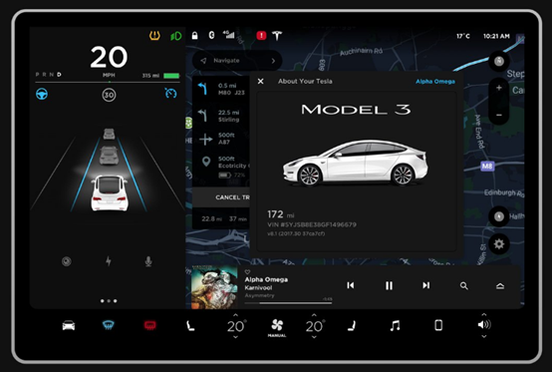
Value Proposition Canvas
Value Proposition Canvas
for Tesla
Customer jobs
Customer gains
Drive to work
Unique personal transport
Be adequate for long distance driving
Customer pains
High speed
High safety
Brand recognition
Fashion design
Lack of charging stations
Needs to be recharged frequently
Fear of accidents
Price drop after purchasing
Products & Services
Model 3, X, Y and S
8 year battery lifespan
High-satisfaction after sale services
Gain creators
High-tech touchscreen
High focus on style&design
Autonomous mode
0-100km/h 4.4s – 6.2s
Pain relievers
Tesla supercharge
High safety rating
262km-405km one single charge

Slide 14
Value Proposition Canvas
Value Proposition Canvas
for Tesla
Customer jobs
Customer gains
Drive to work
Unique personal transport
Be adequate for long distance driving
Customer pains
High speed
High safety
Brand recognition
Fashion design
Lack of charging stations
Needs to be recharged frequently
Fear of accidents
Price drop after purchasing
Products & Services
Model 3, X, Y and S
8 year battery lifespan
High-satisfaction after sale services
Gain creators
High-tech touchscreen
High focus on style&design
Autonomous mode
0-100km/h 4.4s – 6.2s
Pain relievers
Tesla supercharge
High safety rating
262km-405km one single charge

Slide 15
Value Proposition Canvas for Amazon
Customer jobs
Customer gains
Customer pains
Functional job: Placing order with one click
Emotional job: Satisfy online shopping wishes
Doorstep delivery
Convenience of online shopping
Hassle free return
Long delivery time
Items out of stock
Lost or damaged items during delivery
Products & Services
Amazon Prime
Amazon customer service
Traditional delivery stations and facilities
Testing on autonomous delivery robot
Gain creators
Amazon platform with user-friendly UI
Filter of items based on categories or price range
Pain relievers
Secure payment methods
Easy check out
7 day trail policy
Faster delivery options
Cooperate with other delivery companies

Slide 16
Value Proposition Canvas for Amazon
Customer jobs
Customer gains
Customer pains
Functional job: Placing order with one click
Emotional job: Satisfy online shopping wishes
Doorstep delivery
Convenience of online shopping
Hassle free return
Long delivery time
Items out of stock
Lost or damaged items during delivery
Products & Services
Amazon Prime
Amazon customer service
Traditional delivery stations and facilities
Testing on autonomous delivery robot
Gain creators
Amazon platform with user-friendly UI
Filter of items based on categories or price range
Pain relievers
Secure payment methods
Easy check out
7 day trail policy
Faster delivery options
Cooperate with other delivery companies

Slide 17
Value Proposition Canvas for Amazon
Customer jobs
Customer gains
Customer pains
Functional job: Placing order with one click
Emotional job: Satisfy online shopping wishes
Doorstep delivery
Convenience of online shopping
Hassle free return
Long delivery time
Items out of stock
Lost or damaged items during delivery
Products & Services
Amazon Prime
Amazon customer service
Traditional delivery stations and facilities
Testing on autonomous delivery robot
Gain creators
Amazon platform with user-friendly UI
Filter of items based on categories or price range
Pain relievers
Secure payment methods
Easy check out
7 day trail policy
Faster delivery options
Cooperate with other delivery companies

Slide 18
Value Proposition Canvas for Amazon
Customer jobs
Customer gains
Customer pains
Functional job: Placing order with one click
Emotional job: Satisfy online shopping wishes
Doorstep delivery
Convenience of online shopping
Hassle free return
Long delivery time
Items out of stock
Lost or damaged items during delivery
Products & Services
Amazon Prime
Amazon customer service
Traditional delivery stations and facilities
Testing on autonomous delivery robot
Gain creators
Amazon platform with user-friendly UI
Filter of items based on categories or price range
Pain relievers
Secure payment methods
Easy check out
7 day trail policy
Faster delivery options
Cooperate with other delivery companies

Slide 19
Value Proposition Canvas for Amazon
Customer jobs
Customer gains
Customer pains
Functional job: Placing order with one click
Emotional job: Satisfy online shopping wishes
Doorstep delivery
Convenience of online shopping
Hassle free return
Long delivery time
Items out of stock
Lost or damaged items during delivery
Products & Services
Amazon Prime
Amazon customer service
Traditional delivery stations and facilities
Testing on autonomous delivery robot
Gain creators
Amazon platform with user-friendly UI
Filter of items based on categories or price range
Pain relievers
Secure payment methods
Easy check out
7 day trail policy
Faster delivery options
Cooperate with other delivery companies

Slide 20
Value Proposition Canvas for Amazon
Customer jobs
Customer gains
Customer pains
Functional job: Placing order with one click
Emotional job: Satisfy online shopping wishes
Doorstep delivery
Convenience of online shopping
Hassle free return
Long delivery time
Items out of stock
Lost or damaged items during delivery
Products & Services
Amazon Prime
Amazon customer service
Traditional delivery stations and facilities
Testing on autonomous delivery robot
Gain creators
Amazon platform with user-friendly UI
Filter of items based on categories or price range
Pain relievers
Secure payment methods
Easy check out
7 day trail policy
Faster delivery options
Cooperate with other delivery companies

Slide 21
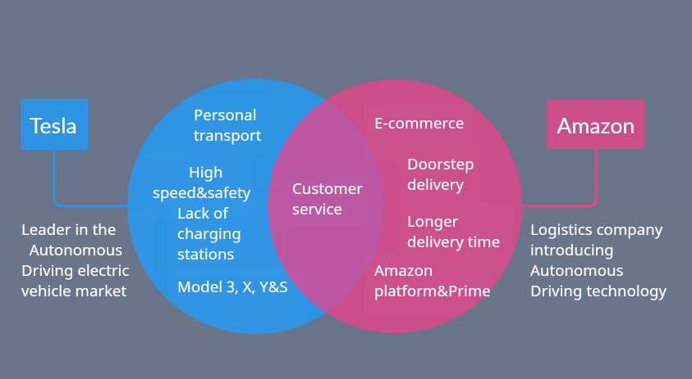
Value Proposition Canvas Comparison

Slide 22
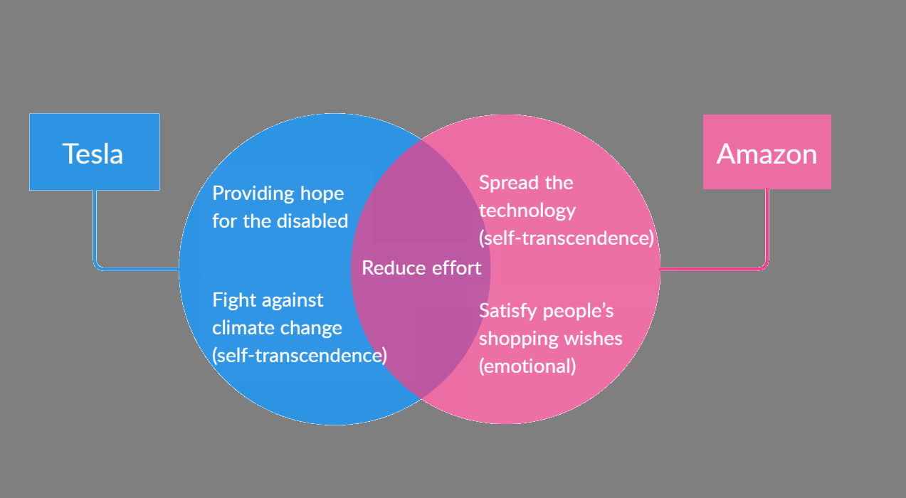
Value Pyramid Comparison

Slide 23
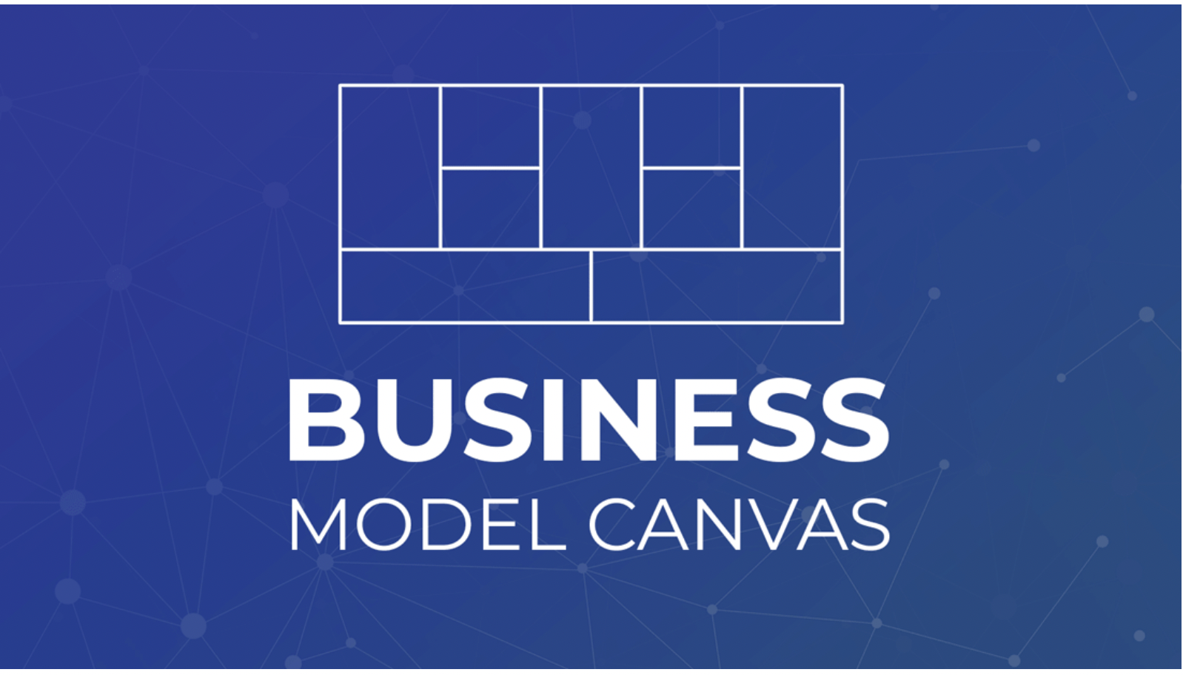
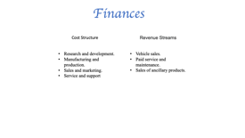
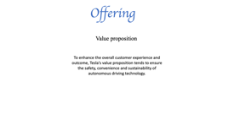
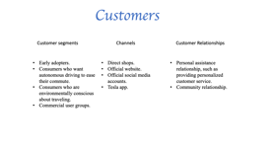
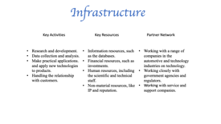
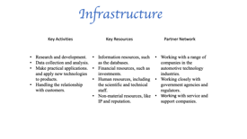
Tesla

Slide 24
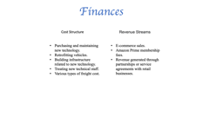
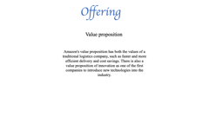
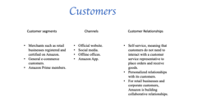
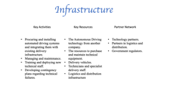
Amazon

Slide 25
Business Model Comparison
Tesla
Amazon
Value proposition
Key resources
Partner network
….
Value proposition
Key resources
Partner network
…
Channel

Slide 26
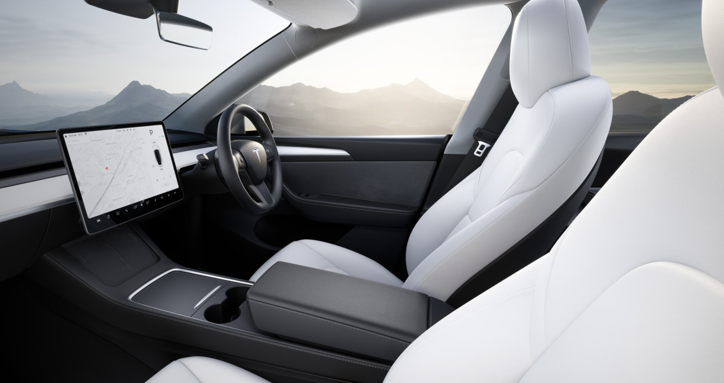

Impact of Emerging Technology on Future Innovation
reduce the demand for personal vehicles (more choices in shared services such as co-taxis)

Slide 27
Impact of Emerging Technology on Future Innovation
reduce the demand for personal vehicles (more choices in shared services such as co-taxis)
Diversifying its business model to include autonomous ride-sharing services or other transportation-related services.

Slide 28

Impact of Emerging Technology on Future Innovation
Develop new types of autonomous vehicles optimized for last-mile delivery or expand its use of autonomous trunks for deliveries.
Designing its own new software, machine learning algorithms, and autonomous driving delivery systems

Slide 29

IP Protection
Patent
Innovative technologies related to autonomous driving level 4, which could involve its key technologies, processes, car designs, and developing strategies
Trademarks
Algorithms, software code, or engineering designs

Slide 30

Thank you
References:
Arrieche, A. (2023) Biggest Electric vehicle companies: What you need to know, Biggest Electric Vehicle Companies | What You Need to Know. Available at: https://capital.com/top-20-global-electric-vehicle-companies-ranking-tesla-ev-top-dog#:~:text=Who%20sells%20the%20most%20EVs,production%20increased%20to%201.37%20million.
Chesterton, A. (2020, May 25). How long do tesla batteries really last? Model S tested after 250,000 kilometres. CarsGuide. https://www.carsguide.com.au/car-news/how-long-do-tesla-batteries-really-last-model-s-tested-after-250000-kilometres-78484
DANNY SHAPIRO. (June 22, 2021). Tesla Unveils Top AV Training Supercomputer Powered by NVIDIA A100 GPUs. Retrieved from https://blogs.nvidia.com/blog/2021/06/22/tesla-av-training-supercomputer-nvidia-a100-gpus/
DTechEx. (2022). Figure 3.4: Timeline of autonomous car development and commercialization. Retrieved from https://www.idtechex.com/en/research-report/autonomous-cars-robotaxis-and-sensors-2022-2042/832
Daniel, S. (2022, December 9). Without a garage, Miriam and guy plan their week around charging their electric car. ABC News. https://www.abc.net.au/news/2022-11-29/lack-of-street-chargers-for-electric-cars-a-problem-for-buyers/101461778
Dickerson, M. (2023, February 7). You will get a definite charge out of this announcement. The Canberra Times. https://www.canberratimes.com.au/story/8070731/you-will-get-a-definite-charge-out-of-this-announcement/
Greene, J. (2020, May 21). Frustrated Amazon Shoppers Vent at record levels. The Washington Post. https://www.washingtonpost.com/technology/2020/05/21/amazon-shopper-complaints/
Global Industry Classification Standard. (n.d.). Retrieved March 21, 2023, from https://en.wikipedia.org/wiki/Global_Industry_Classification_Standard.
Moorhead, P. (2021, June 30). Amazon Goes All-In On Truck Safety With Autonomous Driving Company Plus. Forbes. Retrieved from https://www.forbes.com/sites/patrickmoorhead/2021/06/30/amazon-goes-all-in-on-truck-safety-with-autonomous-driving-company-plus/?sh=2d112a8660fc
Talpes, E., Sarma, D. D., Venkataramanan, G., Bannon, P., McGee, B., Floering, B., ... & Sachdev, G. S. (2020). Compute solution for Tesla's full self-driving computer. IEEE Micro, 40(2), 25-35.
Tesla owner demographics by age, income, gender, home value (2022) Hedges &amp; Company. Available at: https://hedgescompany.com/blog/2018/11/tesla-owner-demographics/

Slide 31
References:
Arrieche, A. (2023) Biggest Electric vehicle companies: What you need to know, Biggest Electric Vehicle Companies | What You Need to Know. Available at: https://capital.com/top-20-global-electric-vehicle-companies-ranking-tesla-ev-top-dog#:~:text=Who%20sells%20the%20most%20EVs,production%20increased%20to%201.37%20million.
Chesterton, A. (2020, May 25). How long do tesla batteries really last? Model S tested after 250,000 kilometres. CarsGuide. https://www.carsguide.com.au/car-news/how-long-do-tesla-batteries-really-last-model-s-tested-after-250000-kilometres-78484
DANNY SHAPIRO. (June 22, 2021). Tesla Unveils Top AV Training Supercomputer Powered by NVIDIA A100 GPUs. Retrieved from https://blogs.nvidia.com/blog/2021/06/22/tesla-av-training-supercomputer-nvidia-a100-gpus/
DTechEx. (2022). Figure 3.4: Timeline of autonomous car development and commercialization. Retrieved from https://www.idtechex.com/en/research-report/autonomous-cars-robotaxis-and-sensors-2022-2042/832
Daniel, S. (2022, December 9). Without a garage, Miriam and guy plan their week around charging their electric car. ABC News. https://www.abc.net.au/news/2022-11-29/lack-of-street-chargers-for-electric-cars-a-problem-for-buyers/101461778
Dickerson, M. (2023, February 7). You will get a definite charge out of this announcement. The Canberra Times. https://www.canberratimes.com.au/story/8070731/you-will-get-a-definite-charge-out-of-this-announcement/
Greene, J. (2020, May 21). Frustrated Amazon Shoppers Vent at record levels. The Washington Post. https://www.washingtonpost.com/technology/2020/05/21/amazon-shopper-complaints/
Global Industry Classification Standard. (n.d.). Retrieved March 21, 2023, from https://en.wikipedia.org/wiki/Global_Industry_Classification_Standard.
Moorhead, P. (2021, June 30). Amazon Goes All-In On Truck Safety With Autonomous Driving Company Plus. Forbes. Retrieved from https://www.forbes.com/sites/patrickmoorhead/2021/06/30/amazon-goes-all-in-on-truck-safety-with-autonomous-driving-company-plus/?sh=2d112a8660fc
Talpes, E., Sarma, D. D., Venkataramanan, G., Bannon, P., McGee, B., Floering, B., ... & Sachdev, G. S. (2020). Compute solution for Tesla's full self-driving computer. IEEE Micro, 40(2), 25-35.
Tesla owner demographics by age, income, gender, home value (2022) Hedges &amp; Company. Available at: https://hedgescompany.com/blog/2018/11/tesla-owner-demographics/

Slide 32
Infrastructure
Key Activities
Key Resources
Partner Network
Research and development.
Data collection and analysis.
Make practical applications. and apply new technologies to products.
Handling the relationship with customers.
Information resources, such as the databases.
Financial resources, such as investments.
Human resources, including the scientific and technical staff.
Non-material resources, like IP and reputation.
Working with a range of companies in the automotive technology industries.
Working closely with government agencies and regulators.
Working with service and support companies.

Slide 33
Offering
Value proposition
To enhance the overall customer experience and outcome, Tesla's value proposition tends to ensure the safety, convenience and sustainability of autonomous driving technology.

Slide 34
Customers
Customer segments
Channels
Customer Relationships
Early adopters.
Consumers who want autonomous driving to ease their commute.
Consumers who are environmentally conscious about traveling.
Commercial user groups.
Direct shops.
Official website.
Official social media accounts.
Tesla app.
Personal assistance relationship, such as providing personalized customer service.
Community relationship.

Slide 35
Finances
Cost Structure
Revenue Streams
Research and development.
Manufacturing and production.
Sales and marketing.
Service and support
Vehicle sales.
Paid service and maintenance.
Sales of ancillary products.

Slide 36
Infrastructure
Key Activities
Key Resources
Partner Network
Procuring and installing automated driving systems and integrating them with existing delivery infrastructure.
Managing and maintenance.
Training and deploying new technical staff.
Developing contingency plans regarding technical failures.
The Autonomous Driving technology from another company.
The resources to purchase and maintain technical equipment.
Delivery vehicles.
Technicians and specialist delivery staff.
Logistics and distribution infrastructure
Technology partners.
Partners in logistics and distribution.
Government regulators.

Slide 37
Offering
Value proposition
Amazon's value proposition has both the values of a traditional logistics company, such as faster and more efficient delivery and cost savings. There is also a value proposition of innovation as one of the first companies to introduce new technologies into the industry.

Slide 38
Customers
Customer segments
Channels
Customer Relationships
Merchants such as retail businesses registered and certified on Amazon.
General e-commerce customers.
Amazon Prime members.
Official website.
Social media.
Offline offices.
Amazon App.
Self-service, meaning that customers do not need to interact with a customer service representative to place orders and receive goods.
Personalized relationships with its customers.
For retail businesses and corporate customers, Amazon is building collaborative relationships.

Slide 39
Finances
Cost Structure
Revenue Streams
Purchasing and maintaining new technology.
Retrofitting vehicles.
Building infrastructure related to new technology.
Treating new technical staff.
Various types of freight cost.
E-commerce sales.
Amazon Prime membership fees.
Revenue generated through partnerships or service agreements with retail businesses.

